Slide 1
Urban Code Deploy

Slide 2
Features
Tool offers automated application deployment through different application environments.
Urban Code Deploy supports static content deployments in a number of forms: file transfer, incremental updates, and rollback using secure transport.
Continuous Delivery: Integrate with build and test tools to automatically deploy, test and promote new builds.
Easy tracking of applications and components in different environments.

Slide 3
Clear visibility: what is deployed where and who changed what.
Artifact repository: store deployment artifacts more securely to enable traceability.
Currently used version - 6.1.1.6
https://10.56.183.184:8443/ - cloud instance
(Here, tomcat server and derby as database ) or if you want specify database you want to specify it at the time of installation of u deploy.

Slide 4
Component - All the artifacts are stored.
Application - To sequence the components created.
Process - Flow of deployment is defined here.
Code Station - Details about the artifacts are stored
Agent – Communication between server and workstation.
Agent Pool – A set of agents can be used for some automated action.

Slide 5
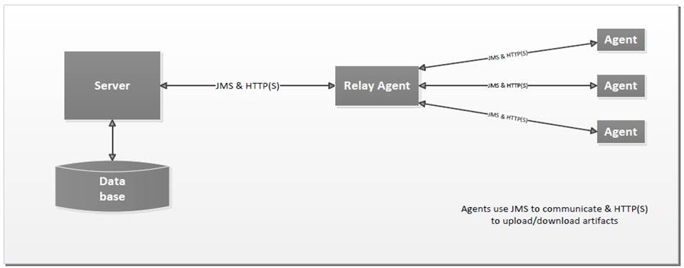
ARCHITECTURE

Slide 6
IBM uDeploy architecture consists of a service tier and a data tier.
The service tier has a central server that provides a web server front-end and core services, such as workflow, agent management, deployment, inventory, security, as well as others.
Most server-agent communication is done via JMS but HTTP(S) is also used as required.

Slide 7
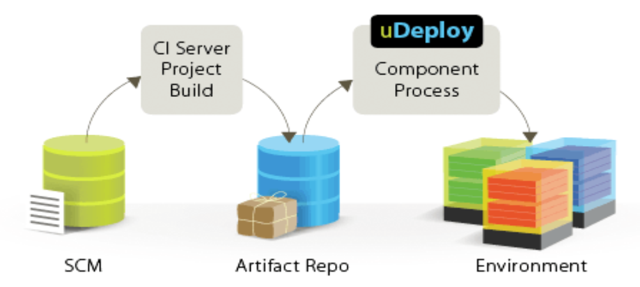
Process Flow

Slide 8
Agent communications use SSL encryption and mutual keybased
authentication. For added security, agents do not listen to ports, but open direct connections to the server instead.

Slide 9
Supporting Technologies
Source Control: RTC, SVN, Git, ClearCase.
Application servers: JBoss, IIS, Tomcat, WebLogic.
Databases: MS SQL Server, Oracle SQL*Plus, JDB.
Change Management: RTC, ClearQuest, Jira, TFS.
Quality Assurance: HPQC, Selenium, Sonar.
Build: Ant, Maven.

Slide 10
THANK YOU

